Slide 1

Bank Note Authentication
By,
Ayush Kale
Satish Kamble
Shraddha Dalal
Batch
PGA 33

Slide 2
Agenda
Introduction
Resume
Problem statement
Attribute information
Visualization
Model
Result
Report
Conclusion

Slide 3
Introduction
Despite use of electronic transactions, cash transactions remain very important in the global market.
To continue with smooth cash transactions, entry of forged banknotes in circulation should be preserved.
There has been a drastic increase in the rate of fake notes in the market.
Fake notes are created in all denominations, it’s looks like real which brings the financial market to a low level.
It is difficult for human-eye to recognize a fake note because they are created with great accuracy to look alike a genuine note.

Slide 4

Problem Statement
The main objective is to predict whether the Bank note is real or fake.
Machine learning algorithms learn from the dataset. Therefore, to identify whether a banknote is real or not, we needed a dataset of real as well as fake banknotes along with their different features.

Slide 5
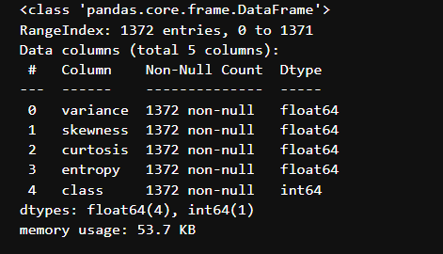
Attribute Information
Attribute Name | Value Type | Description
Variance | Continuous | Variance finds how each pixel varies from the neighboring pixels
Skewness | Continuous | Skewness is the measure of the lack of symmetry
Kurtosis | Continuous | Kurtosis is a measure of whether the data are heavy-tailed or light-tailed relative to a normal distribution
Entropy | Continuous | Image entropy is a quantity which is used to describe the amount of information which must be coded for, by a compression algorithm
Class | Integer | Class contains two values 0 representing genuine note and 1 representing fake note

Slide 6
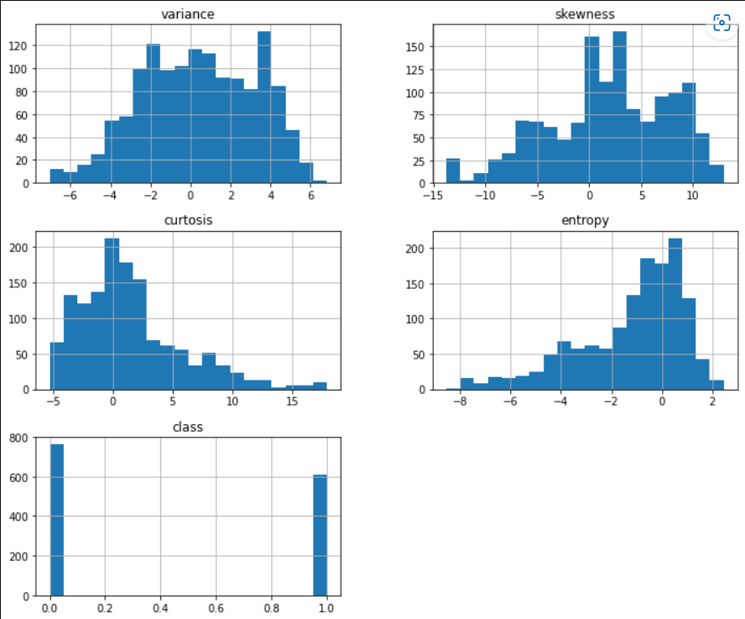
Exploratory Data Analysis
Univariate Analysis
Here we have plotted Histogram for each column and we can see that perhaps the first two variables have a Gaussian-like distribution.
The next two input variables may have a skewed distribution.
There may be some outliers in entropy and curtosis as the data is not normalized.
So to be sure, we’re going to see that using the boxplot.

Slide 7
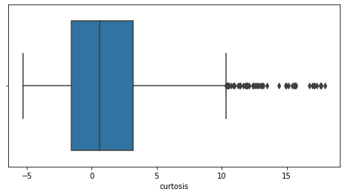
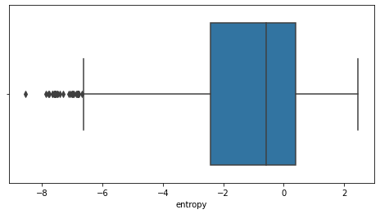
Box Plot
Before Handling Outliers

Slide 8
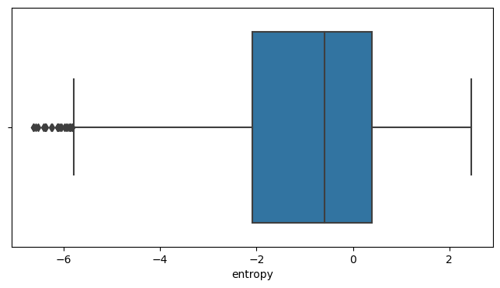
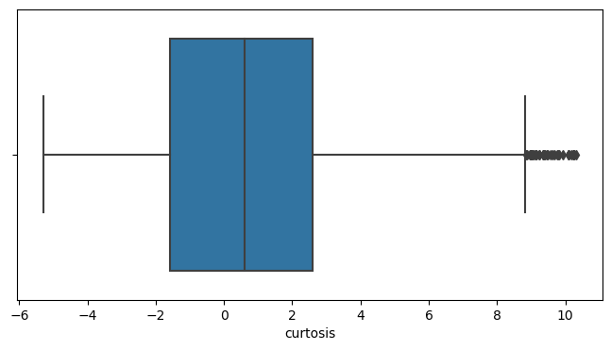
After Handling Outliers

Slide 9
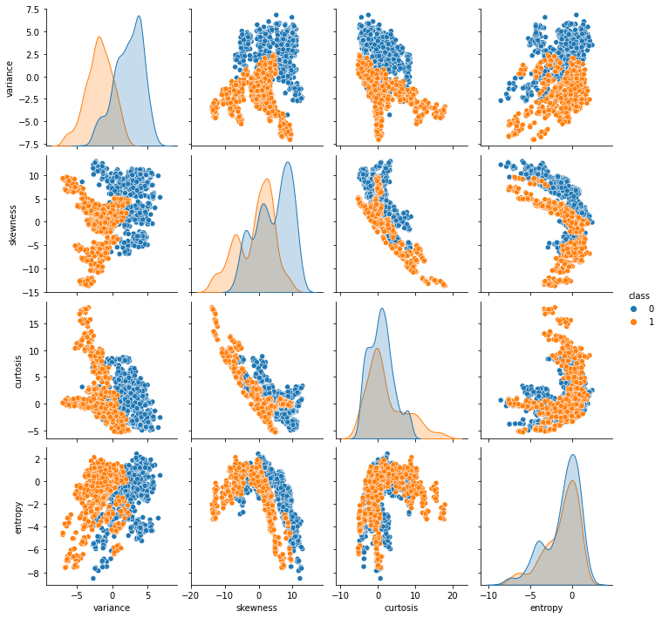
Bivariate Analysis
It is visible from the output that entropy and variance have a slight linear correlation.
Similarly, there is an inverse linear correlation between the curtosis and skewness.
Finally, we can see that the values for curtosis and entropy are slightly higher for real banknotes
While the values for skewness and variance are higher for the fake banknotes.

Slide 10
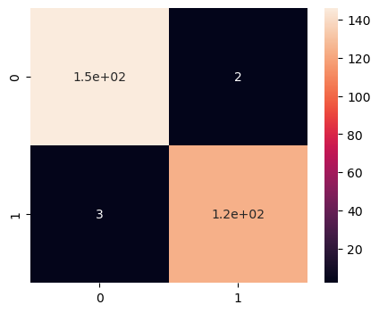
Confusion Matrix
The confusion matrix is a matrix used to determine the performance of the classification models for a given set of test data.

Slide 11
Model
We have implemented various machine learning algorithms to find the most optimal model. The algorithms are-
K-Nearest Neighbor
K Nearest Neighbour is a simple algorithm that stores all the available cases and classifies the new data or case based on a similarity measure.
Naive Bayes
A Naive Bayes classifier is a probabilistic machine learning model that's used for classification task.
Logistic Regression
Logistic regression is a statistical analysis method to predict a binary outcome, such as yes or no, based on prior observations of a data set.
Decision Tree Classifier
A decision tree is a very specific type of probability tree that enables you to make a decision about some kind of process.
Random Forest Classifier
Random Forest is a classifier that contains a number of decision trees on various subsets of the given dataset and takes the average to improve the predictive accuracy of that dataset.

Slide 12
Ensemble Techniques
Ensemble simply means combining multiple models. Thus a collection of models is used to make predictions rather than an individual model.
Bagging
It creates a different training subset from sample training data with replacement & the final output is based on majority voting. For example, Random Forest.
Pasting
When Sampling is performed without replacement.
AdaBoost
AdaBoost is an ensemble learning method (also known as “meta-learning”) which was initially created to increase the efficiency of binary classifiers. AdaBoost uses an iterative approach to learn from the mistakes of weak classifiers, and turn them into strong ones.
Gradient Boost
Gradient Boosting Algorithm is generally used when we want to decrease the Bias error.

Slide 13
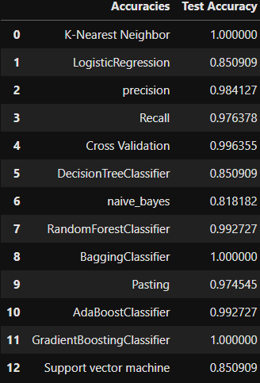
Report
These are the accuracies for the different classification algorithms.

Slide 14

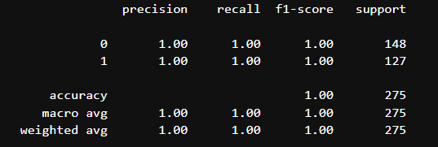
Result
The result shows that Bagging Classifier outperforms all other machine learning algorithms and gives 100% success rate.

Slide 15
Conclusion
Banknote authentication is an important task, It is difficult to manually detect fake bank notes.
As per the analysis Bagging Classifier Gives best accuracy as compared to other machine learning Algorithms.

Slide 16
Thank You!!

